Slide 1
iFood CRM Data Analyst Case
How to build a predictive model that will produce the highest profit for the next direct marketing campaign

Slide 2
The problem
Company
Context
Problem
A well-established company operating in the retail food sector. Presently they have around several hundred thousand registered customers and serve almost one million consumers a year.
The marketing department was pressured to spend its annual budget more wisely. The CMO perceives the importance of having a more quantitative approach when taking decisions.
Build a predictive model that will produce the highest profit for the next direct marketing campaign, scheduled for the next month.

Slide 3
Challenges
Challenge 1
Challenge 2
Challenge 3
Exploratory Analysis
Explore data to find patterns and problems
Transform Data
Transform data to use them to build a relevant model
Build a predictive Model
Build, train and test the Best model..

Slide 4
Exploratory Analysis
I focused to analyze the data for the customers who accepted the offer in the last campaign

Slide 5
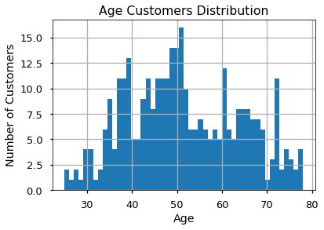
Challenge 2
Challenge 3

Slide 6
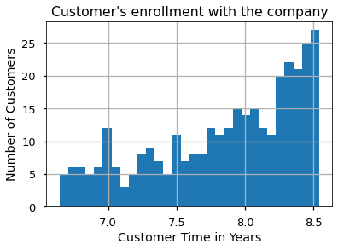
Challenge 2
Challenge 3

Slide 7
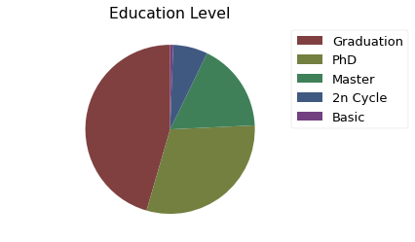
Challenge 2
Challenge 3

Slide 8
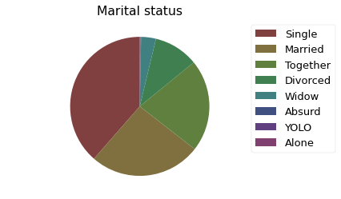
Challenge 2
Challenge 3

Slide 9
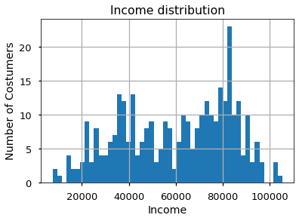

Slide 10
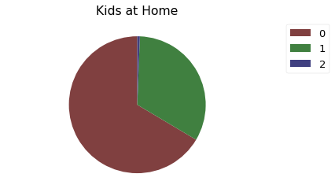

Slide 11
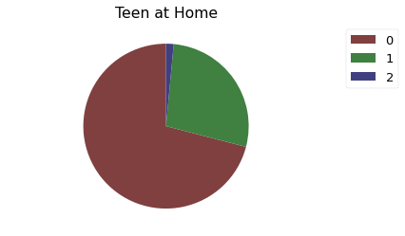

Slide 12
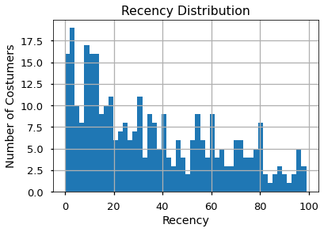

Slide 13
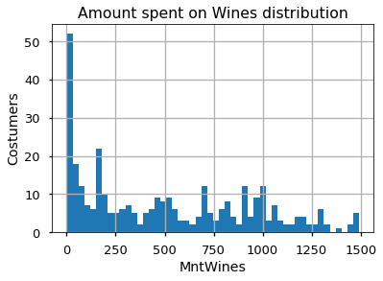

Slide 14
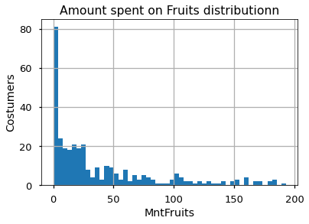

Slide 15
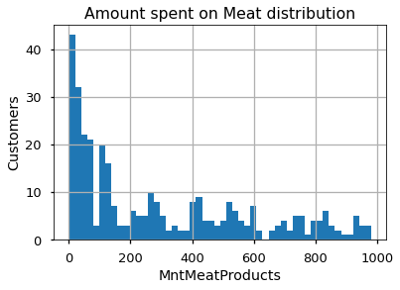

Slide 16
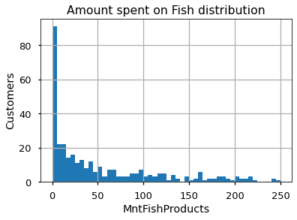

Slide 17
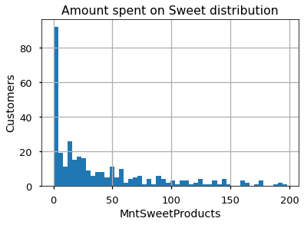

Slide 18
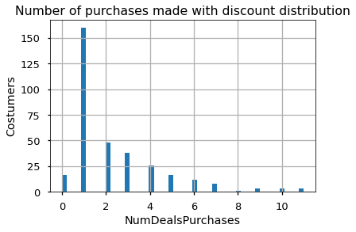

Slide 19
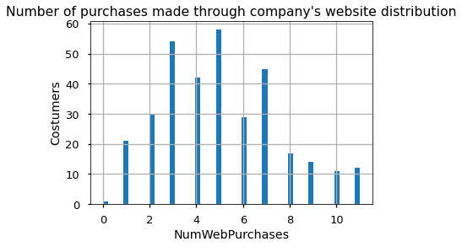

Slide 20
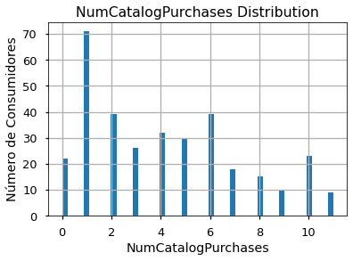

Slide 21
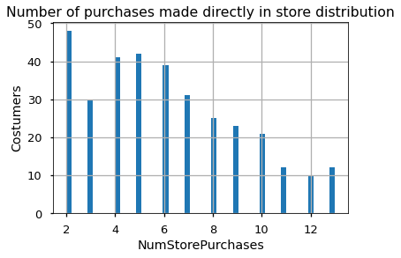

Slide 22
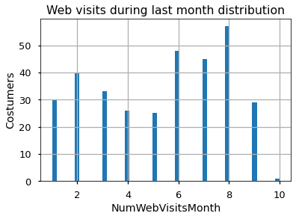

Slide 23
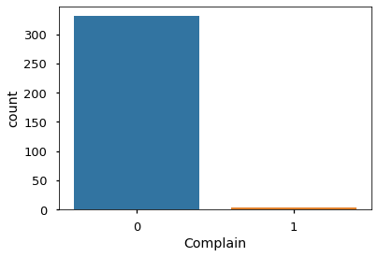

Slide 24
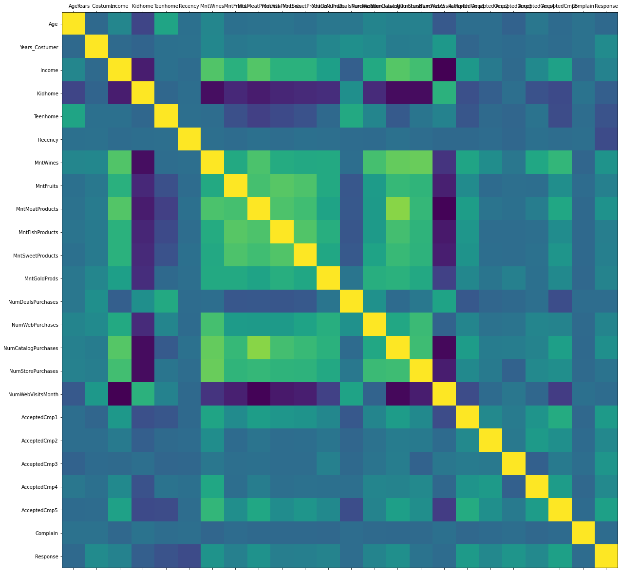
Correlation Map

Slide 25
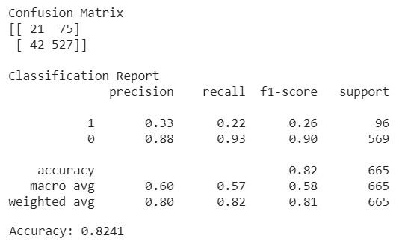
Naive Bayes Classifier
Metrics

Slide 26
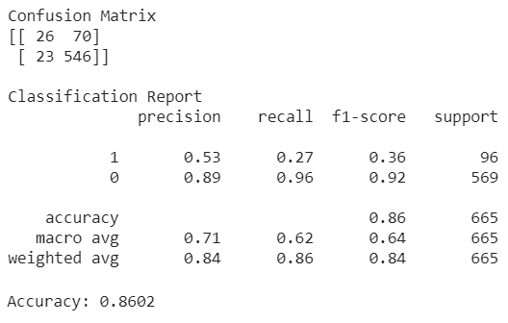
Random Forest
Metrics

Slide 27
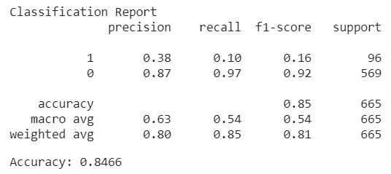
Logistic Regression
Metrics

Slide 28
Summary
Accuracy using models with test data
Naive Bayes = 0.8241
Random Forest = 0.8602
Logistic Regression = 0.8466

